Slide 1
IEEE Code of Ethics

Slide 2
IEEE: Institute of Electrical and Electronics Engineering
IEEE is an organization composed of engineers, scientists, and students.
The IEEE is best known for developing standards for the computer and electronics industry.
IEEE, an association dedicated to advancing innovation and technological excellence for the benefit of humanity, it is the world's largest technical professional society.
It is designed to serve professionals involved in all aspects of the electrical, electronic, and computing fields and related areas of science and technology that underlie modern civilization.

Slide 3
What are Ethics…….?
The way people behave based on how their beliefs about what is right and wrong influence behavior.
Ethics comes from the Greek word ‘Ethos’ meaning character, or what a good person is or does to have a good character.
Ethics refers to a set of principles of right conduct. You need to decide what is right or what is wrong, what is good and what is evil.

Slide 4
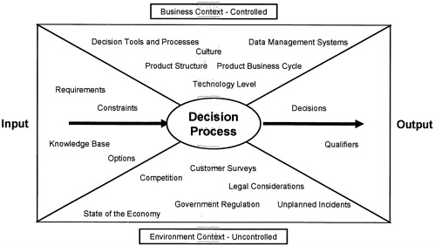
Our Responsibilities
To accept responsibility in making engineering decisions consistent with the safety, health and welfare of the public, and to disclose promptly factors that might endanger the public or the environment.

Slide 5
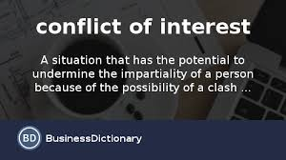
Our Responsibilities Contd….
To avoid real or perceived conflicts of interest whenever possible, and to disclose them to affected parties when they do exist.

Slide 6

Our Responsibilities Contd….
To be honest and realistic in stating claims or estimates based on available data.
To reject bribery in all its forms.

Slide 7

Our Responsibilities Contd….
To improve the understanding of technology, its appropriate application, and potential consequences.

Slide 8
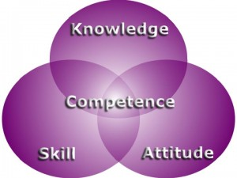
Our Responsibilities Contd….
To maintain and improve our technical competence and to undertake technological tasks for others only if qualified by training or experience, or after full disclosure of limitations.

Slide 9

Our Responsibilities Contd….
To seek, accept, and offer honest criticism of technical work, to acknowledge and correct errors, and to credit properly the contributions of others.

Slide 10
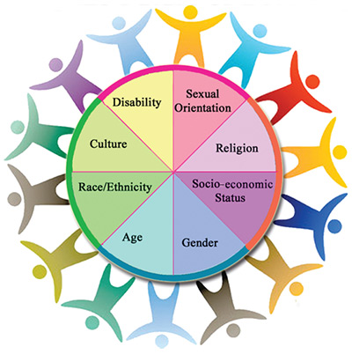
Our Responsibilities Contd….
To treat fairly all persons regardless of such factors as race, religion, gender, disability, age, or national origin.

Slide 11
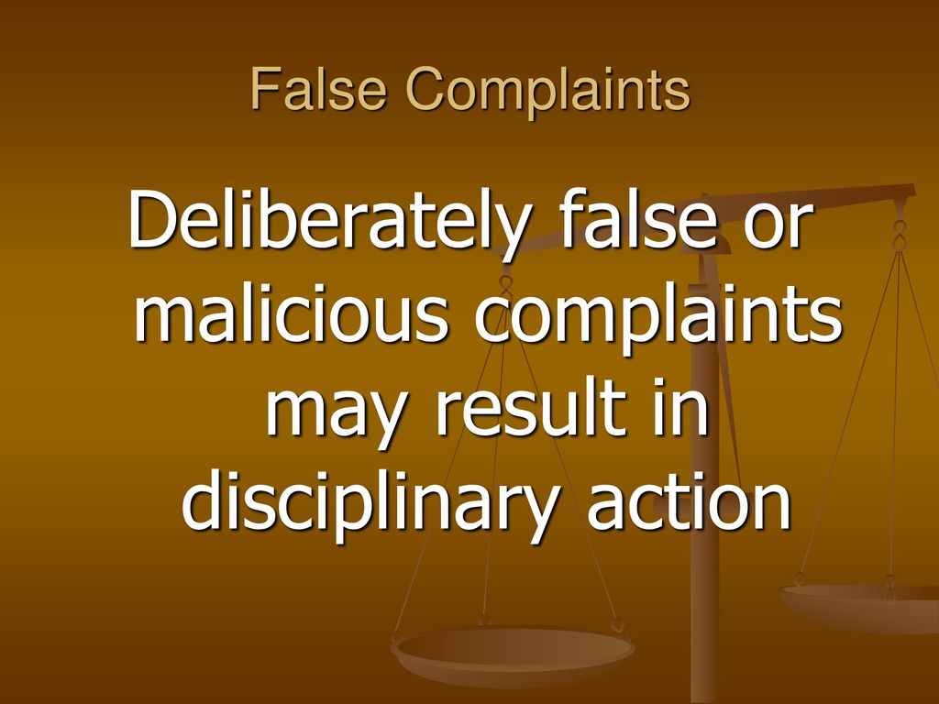
Our Responsibilities Contd….
To avoid injuring others, their property, reputation, or employment by false or malicious action.

Slide 12

Our Responsibilities Contd….
To assist colleagues and co-workers in their professional development and to support them in following this code of ethics.

Slide 13
Women in Engineering

Slide 14
Introduction
ENGINEERING HAS ALWAYS been a ‘man’s world’ and while women are no longer strangers to it, the numbers remain too few even today, in most parts of the world.
India with its already low female literacy rates is no exception to such skewed gender distributions.
Statistics about the presence of women in different disciplines and levels were compiled from various sources in India. Factors are explained further that may explain why women often choose NOT to do engineering are explored and possible solutions suggested.

Slide 15
Statistics about lack of women in Engineering
Statistics regarding the percentage of women in various disciplines and at different degree levels have been reported by Bamji (2005) and are shown in Table 1.
The presence of women in Engineering is much lower than in the Sciences, Arts and Medicine at the Bachelor’s level.
In all cases except Engineering, Science and Agri , the percentages decrease as the educational level increases.
There is a small percent increase in women doing Ph.D.s as compared to those doing Masters in Engineering.

Slide 16
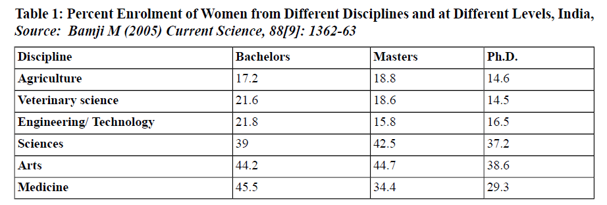
Table-1

Slide 17
1. Flexibility at the workplace:
Increased number of women at the workplace not only has brought several positive changes but it also has made organizations look more closely at the problems of employees.
These positive changes enable employers to address unique issues like helping workers balance professional and family life etc. With more and more women coming to the workplace, the attitude and mindset of employers have been changed.
With the coming of women to the workforce, the management has to bring several new programs and changes that benefit both males and females.
Facilities like childcare, ATM machine at work, work from home, elder care, oil change etc were not offered by the management before women started to enter the workforce.

Slide 18
2. Healthy work-life balance:
When it comes to create and maintain a healthy balance between work and life, women outshine men. From taking care of kids and family to giving excellent performance in office, women master the art of balancing job and family pretty well.
Whether single or married, women understand the value of participating in non-work-related activities. They understand work is not everything, to be productive and happy at the workplace some non-work related activities should be introduced or organized.
Flexible work schedules, work from home facility etc make it possible for women to maintain a good work-life balance.

Slide 19
3. Effective communication for collaborative work effort:
According to experts, women are great communicators as they respond more effectively to visual, verbal, and emotional factors than men.Women are endowed with strong communication and networking skills using which they can encourage any collaborative or group work efforts.Usually, who feels discomfort handling emotions prefer to give directives and share competitive stories with team members.On the contrary, women listen to team members carefully, share ideas, and give the advice to encourage teamwork, while maintaining professionalism.

Slide 20
4. Well rounded workforce:
When it comes to sensitivity and intuition, women outrun men. Their sensitivity, intuition and emotional intelligence help to create a well-rounded workforce. While men lack in understanding one’s unspoken words or emotions, women decode verbal cues and body language easily and this quality makes them a very effective problem solver.Even a few decades back, women were perceived as irrational, sensitive and emotional creatures who are totally unfit for working outside the home.But now women are doing better as team leaders than men due to their sensitive nature, which helps them to understand unspoken words or emotions. With this quality, women are able to address and resolve any workplace problems or tension before they crop up.

Slide 21
Strong team spirit and feeling of togetherness:
Women value relationships and analyze the problem better. If these mind-blowing characteristics of them are brought into workplace it can result in great team-building or group effort that will work for the benefit of the organization.
Women use their relationship building and communication skill to manage a team efficiently. She can make every employee of her team feel that their effort and contribution have been valued.
No man will lend an ear to listen to other personal problems while women have the patience to hear out and understand your emotions. The compassion she shows with her staff helps to boost their levels of productivity.
Women don’t usually have a command-and-control approach like men, allowing the employees feel good and an important part of a team. A woman can also use this skill to get information and understand others’ point of view.

Slide 22
. Deal with a tough situation with a smile on face:
Women are calm and tolerant than men, making them to be composed when dealing with a tough situation or radical changes. The modern work environment is full of tension and complexities.
Women, who tend to have quiet and less aggressive nature, can handle these tensions and complexities better than men. Using these qualities they understand any concern better than men and formulate a solution quickly.
Women are mentally powerful than man so handling any tough situation is comparatively easy for them. They can tackle problems efficiently without giving tensions to her colleagues or team members.
When confronted with an adverse situation, women look for the opportunity within. They are optimistic and face a diverse situation with their full power.

Slide 23
More profit for company:
Women are great communicators, negotiator, and analyzers. When it comes to tactfully communicate and to bring more business, no one can beat women. They get into details of any matter, analyze it and come with an idea promptly.
As such they become instrumental in bringing in more profits for the company by making sensible and profitable decisions and deals.
Unlike men they also allow employees to share their perspective or point of view before taking any decision. Improved communication with employees and others also increases the loyalty factor in business relationships.

Slide 24
Why are employers so often against hiring women engineers?
Traditionally, engineering jobs demanded long and tough hours on-site and in the field.
Many women were and continue to be discouraged by employers’ expectations or demands and often the discomfort of their male colleagues and/ or family members (reasons include safety concerns, lesser physical abilities or stamina, and long hours away from home).
These factors eliminate a large portion of lucrative engineering jobs resulting in a much smaller share of the job ‘pie’ for women engineers.

Slide 25
What Brings Women to Engineering?
A simple answer to the question above is ‘the same factors that draw male students
Good academic performance
Good long-term job prospects
Diverse job options after graduation
With technological advancements mainly computer-aided design, office based jobs rather than field-based jobs, and better working conditions, women engineers are now able to continue rather than drop out of or change their profession – something the previous generation had to do too frequently!

Slide 26
Why do Women Turn their Backs on Engineering?
A few factors that may explain the small numbers of women in Engineering are enumerated here:
Male-dominated disciplines
Lack of inspiring role models
Women are an insignificant minority with little or no societal, or institutional support
Lack of appropriate infrastructure, design of products, facilities
Lack of organizational flexibility (location, time)
Lack of involvement in decision-making processes, funding opportunities
Dull and depressing professional images in society

